Slide 1
Stock Trend Prediction Final Project

Slide 2




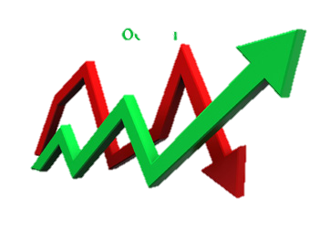
Stock Price

Slide 3
Abstract
Stock Trend Prediction including using
Some ML concepts , deep learning.
Long Short Term Memory(LSTM) model.
Develop a Web Application in Python.

Slide 4

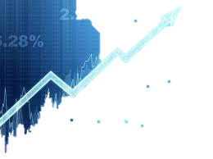
Introduction
Stocks are basically an equity investment that represents part ownership in a corporation or a company it entitles you to a part of that company’s earnings & assets

Slide 5
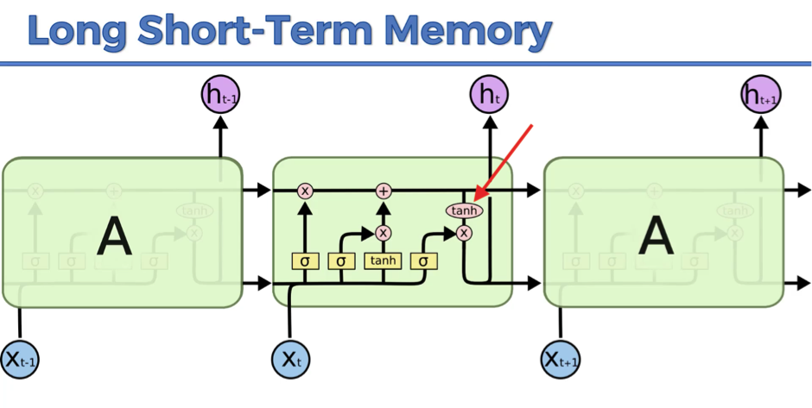
The Concept of LSTM
LSTMs are a variation of the RNN architectures.
With these memory cells, networks are effectively associate memories and input remote in time.
Hence , suit to grasp the structure of data dynamically over time with high prediction capacity.

Slide 6
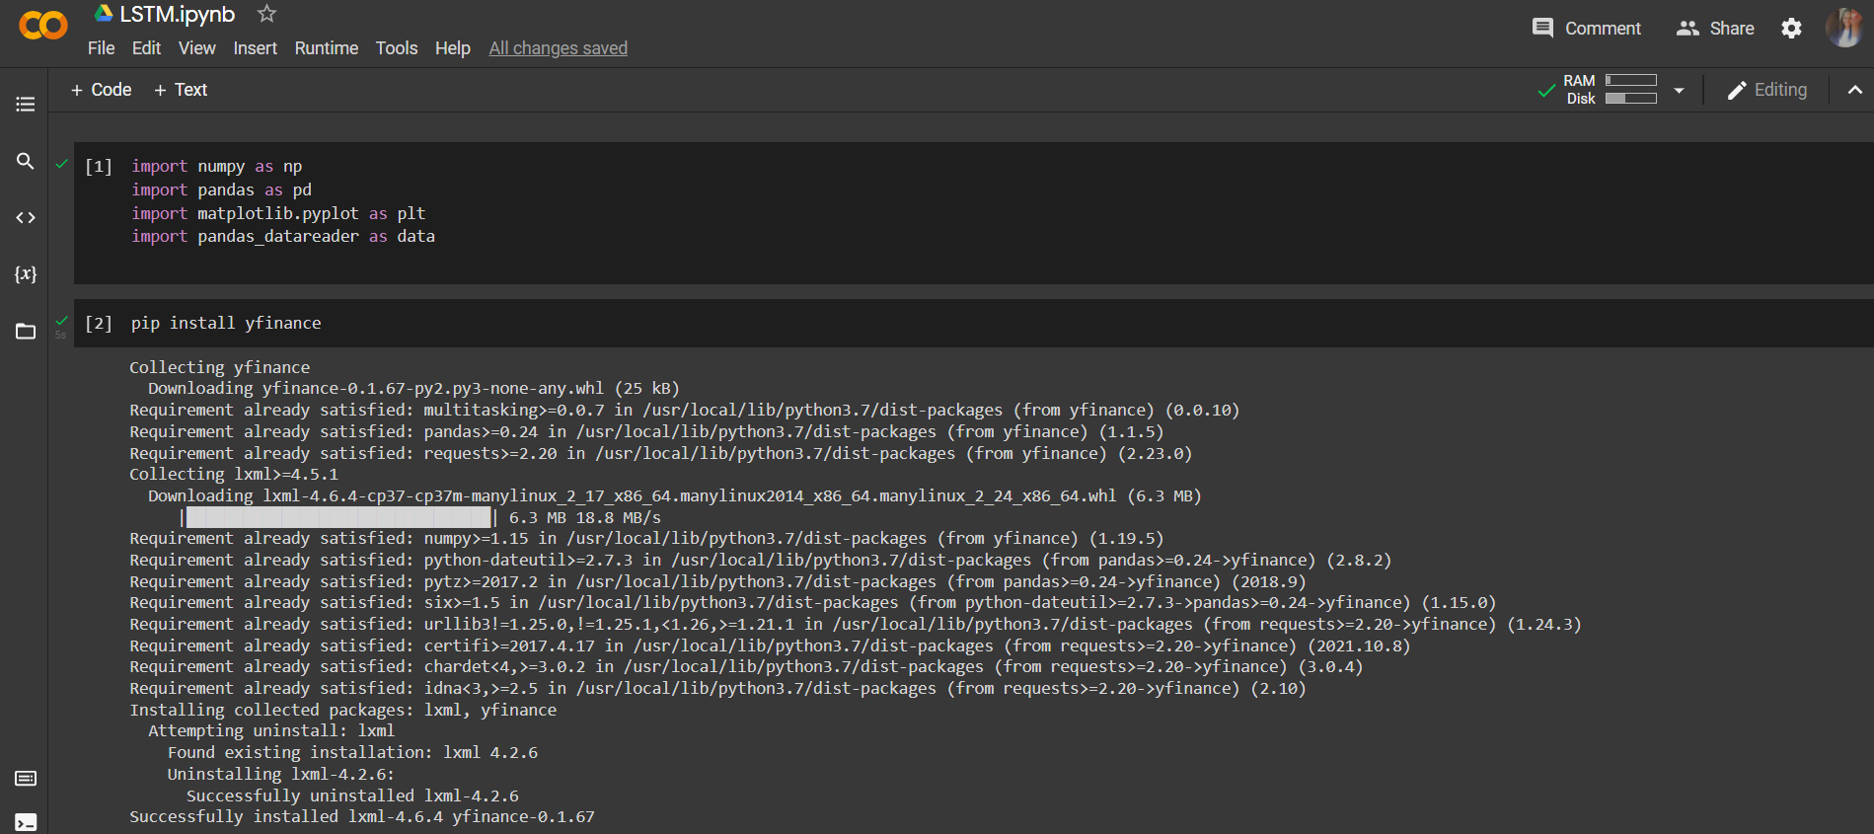
Implementation of Stock Trend Prediction Model
Run on Google Collab

Slide 7
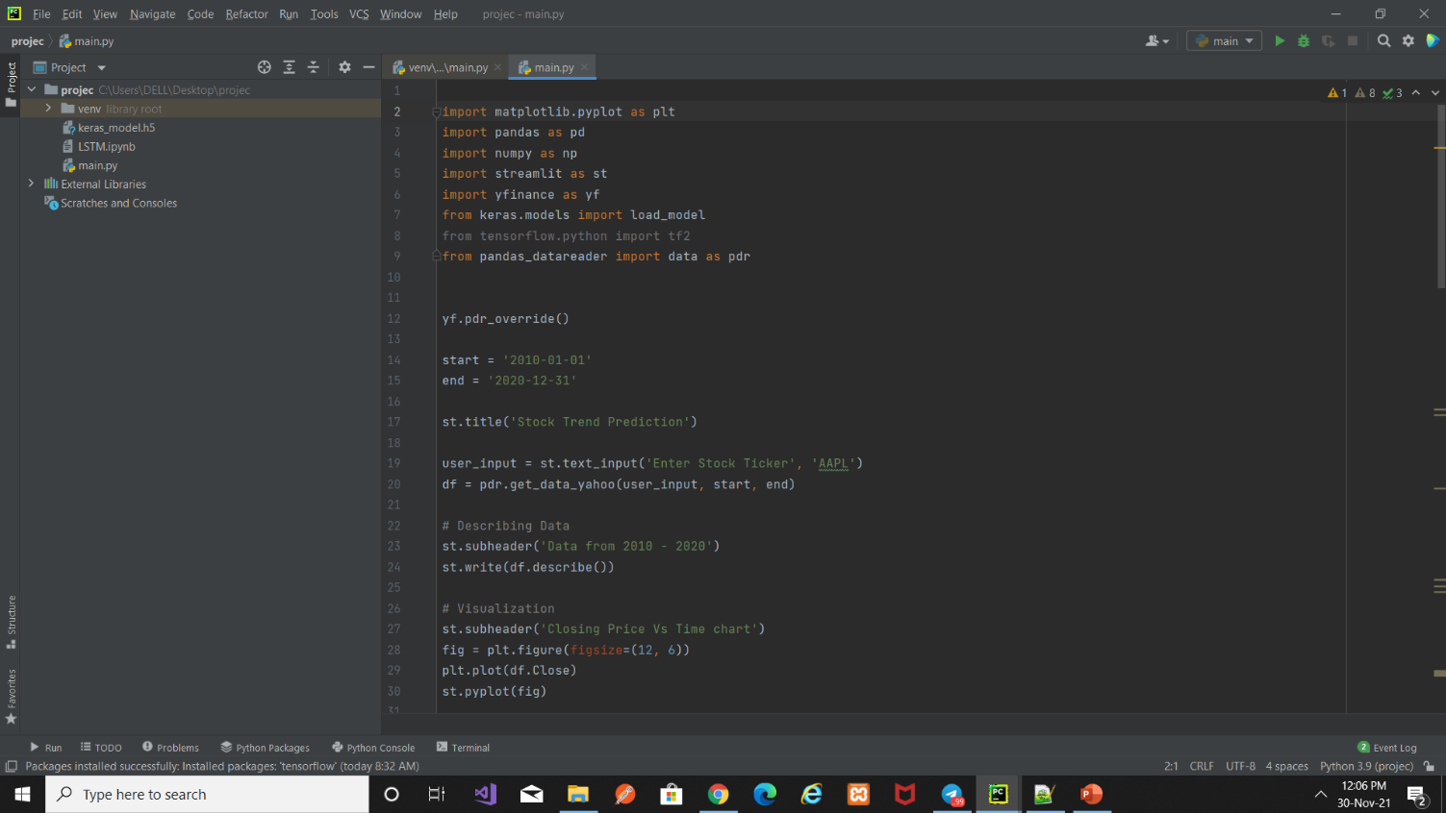
Web Application using Streamlit
Web Application – Pycharm editor

Slide 8
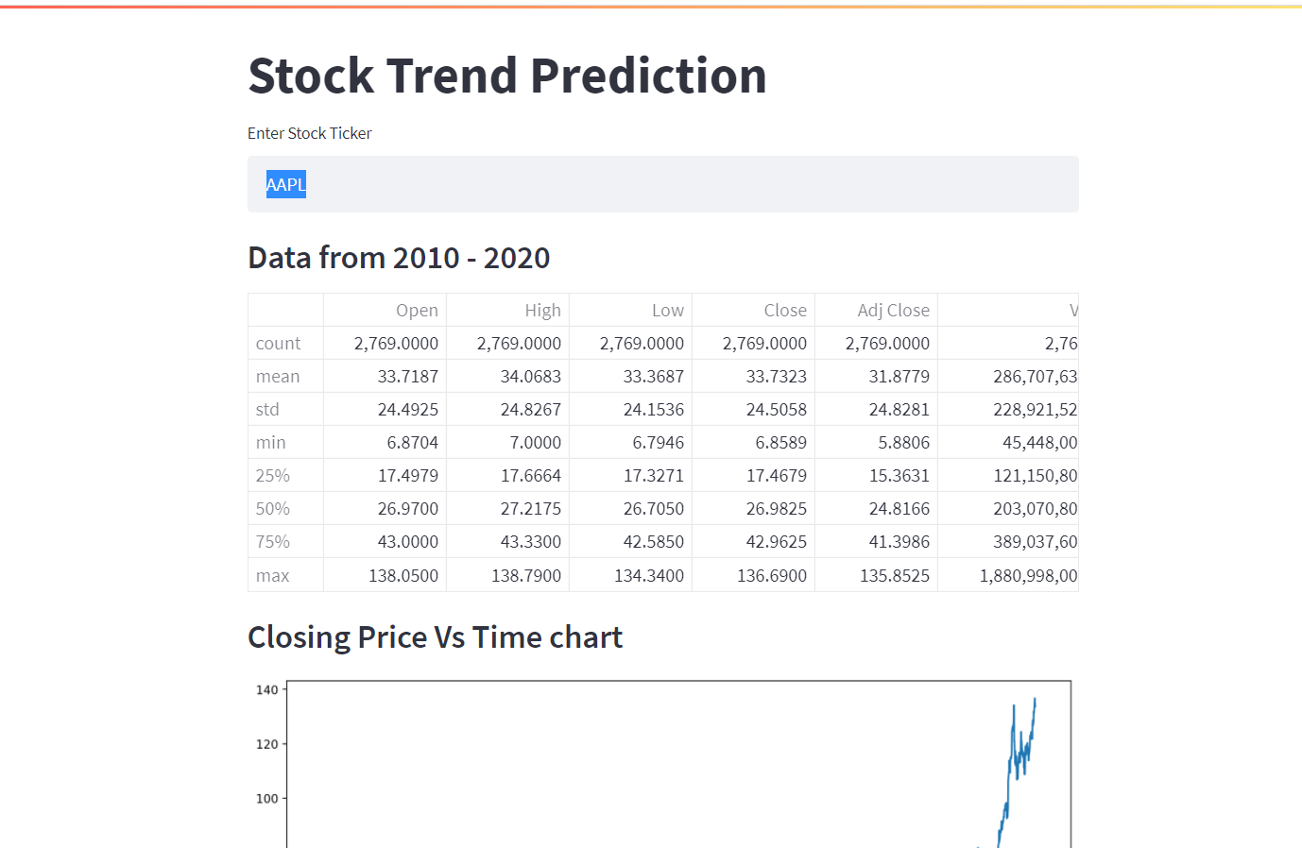
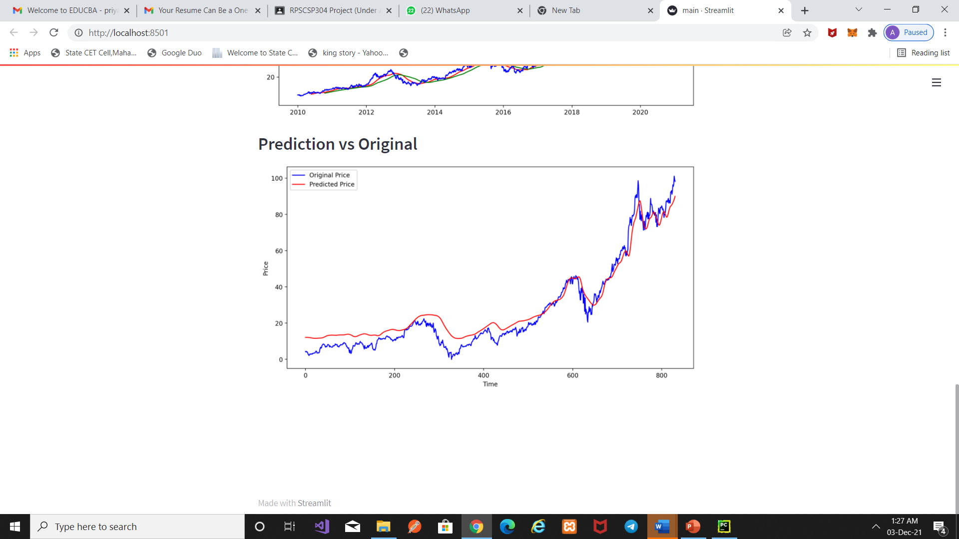
Results

Slide 9
Conclusion
Popularity of stock market trading is growing extremely rapidly which is encouraging researchers to find out new methods for the prediction using new techniques before casting technique is not only helpful to researchers but also helps investors or any person dealing with the stock market in order to help predict the stock indices.
ML Concepts and LSDM units –
Help investors analysts or any person interests in investing in the stock market by providing them a good knowledge of the future generation of the stock market in such a little time atleast we were able to get the trend right.

Slide 10


